Slide 1
Keeping it Cyber Smart
6th Grade Training
2013. Monica Lobenstein, 4-H Youth Development Agent and Alex Galston, AmeriCorps VISTA Member, Jackson County UW-Extension adapted from Annie Lisowski, Buffalo County UW-Extension 4-H Youth Development Agent.
Notes:
Introductions – who you are? From? Grade?
What do you think cyberbullying is?
What have you heard about cyberbullying? -- Give students a chance to respond to these questions
Do you think it’s a big deal?
How does it compare to other types of bullying?
There will be lots of opportunities to share during the presentation, but please don’t use any names.

Slide 2
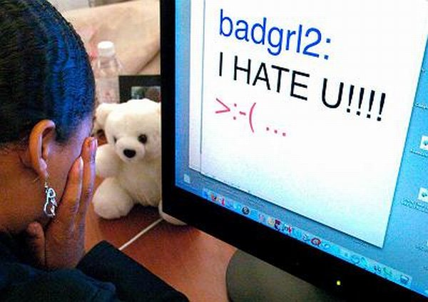
What is cyberbullying?
Cyberbullying is sending or posting mean or embarrassing text or images using the Internet or things like cell phones and video game devices
Notes:
Read the slide aloud.
An example of a picture is someone took a picture of you when you spilled a pop. It looked like you peed your pants and they posted it online.
Another example is that someone sends text messages that say the person is “dumb” or “a slut” or “you’re gonna die.”
Does anyone here play Xbox live or other online games? What kinds of things do you hear people say when you’re in those games?

Slide 3
Who is a friend?
A “friend” is NOT a person:
You first met online
You have only met once
Who is a friend of a friend
Who only “likes” you online
Notes:
Read this slide out loud to reinforce these points.
Do you have any questions about what any of these mean?

Slide 4
FLAMING
Online fights, angry messages or swear words
Notes:
Flaming is common when people comment on Facebook statuses that start fights. Sometimes fights start in “real life” and then carry over into the online world.
Has anyone seen flaming online?
Has anyone sent a message or posted anything online when they were really angry?
If yes, and if they’re comfortable sharing, ask… Did it resolve the situation?

Slide 5
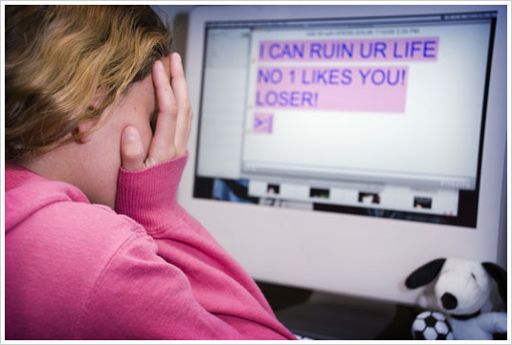
HARASSMENT
Always bothering someone by sending mean messages
Notes:
Harassment is day to day, constantly putting a person down, posting embarrassing pictures or videos, sending mean texts again and again even after they’ve asked you to stop.
Do you know anyone who gets called “stupid” in the hall every day?
This is like that, but online and the person can’t get away from it. Sometimes it’s even more cruel than what happens in person.
Do you know of any other examples of harassment? Things you heard about or seen…

Slide 6
DENIGRATION
Sending or posting gossip or rumors about a person to ruin their reputation or friendships
Notes:
Denigration is a fancy word for gossip or rumors. An example might be if two friends had a fight. One of the friends might start texting their friends that they heard that the other friend is pregnant. The rumor begins to spread through social media and texting and into the real world conversations and snowballs. The person the rumor is about may not even know about it until someone finally confronts them.
Does anyone have any examples of when a rumor was spread about them or someone else?

Slide 7
IMPERSONATION
Pretending to be someone else online to get them in trouble or ruin their reputation or friendships
Notes:
Impersonation is when someone pretends to be a person they’re not to trick another person online. It might be to get secrets from them or personal information or to get them to do something they might not otherwise do. Or it might be to play a trick or cruel prank.
An example might be a group of friends that don’t like Susie. They know that Tom and they create a fake profile for Tom and start messaging and texting Susie to make her think he likes her.
Another example might be if that same group of friends who didn’t like Susie created a fake profile for her. They put out negative messages and picked fights with others pretending to be her so that other people get angry at Susie.
Susie may not know about either situation until she is confronted in the real world.
Have you ever had any experience with or heard of any examples of impersonation?
How did it make you feel? Or how do you think it made the target of the impersonation feel?

Slide 8
OUTING
Sharing someone’s secrets or embarrassing information or photos online
Notes:
Outing is when you share information that a person’s confided in you or asked you not to tell anyone else. This does not just mean exposing another person’s sexual orientation. It could be any secret.
For example, they are doing something they shouldn’t be doing or they have a secret about something in their family life that they don’t want to get out – maybe a divorce in the family… they told you, but they don’t want anyone else to know yet.
There are times when someone might share a secret, but if their secret means that they or someone else might get hurt (they’re thinking about suicide or someone is abusing them), you should still tell an adult. Telling an adult to keep a friend safe is NOT outing. It’s helping!
Do you have any examples of outing that you’ve heard of or experienced?

Slide 9
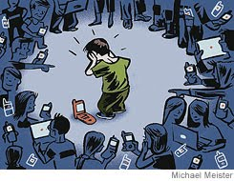
TRICKERY
Tricking someone into revealing secrets or embarrassing information, then sharing it online
Notes:
Trickery is similar to impersonation, so a lot of times a person is lying to another person online or through other media to get information or get them to do something they wouldn’t normally do. When a person gets tricked, the target frequently feels ashamed that they allowed themselves to be tricked, which adds to the emotional bullying that’s happening.
An example might be pretending to be someone else to gain trust and get the target to flash the camera or share a passcode. How many of you have heard about Amanda Todd?
Amanda Todd was a teenage girl in Canada who was chatting online with someone she thought was a teenage boy. They developed a relationship, she started to trust him and thought she was developing feelings for him. He convinced her to flash the camera, and he saved the image. It turns out he was an older man who began to stalk her online. He sent the picture to her classmates and her family and tried to convince her to do things he wanted in real life. In addition to him, other people began bullying her as well. The pressure got to be too much and Amanda and her family moved to try to get away from him, but he continued to stalk her online and send pictures and nasty messages to her new classmates. She eventually died by suicide when she couldn’t escape all of the problems he caused.
Have you heard any other stories in the news or online of this happening?

Slide 10
EXCLUSION
Keeping someone from being your friend online or part of the group just to be mean
Notes:
Do you know what exclusion is?
Exclusion is when you leave someone out of a group for no other reason than “just because.” What would be an example of exclusion in real life?
Exclusion can happen online too. Online, it can be a facebook group or a game group. If you have a group where all you have to do is be in the 6th grade, and it’s an invitation only group. Tom wants to be part of the group because he’s in 6th grad, but Susie doesn’t like him, so she doesn’t allow him to be part of the group.
Another example might be if you had a fight with someone and unfriended on Facebook and you made all your other friends unfriend them too.
Have you heard of or seen other examples of exclusion happening?

Slide 11
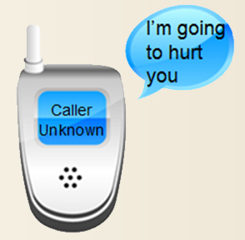
CYBERSTALKING
Harassment that includes threats or makes someone very scared
Notes:
Cyberstalking is very serious! It is similar to harassment where the bully is sending lots of communications that are threatening. We gave an example earlier with Amanda Todd, because the man who tricked her online ended up cyberstalking her, following her online to other places and not leaving her alone.
Have you ever heard of any other examples of cyberstalking?
So what makes cyberbullying different from other types of bullying?

Slide 12
No Escape
Unlike being bullied at school cyberbullying can invade every aspect of your life and follow you where ever you go including your own bedroom
Notes:
With cyberbullying, it can be very hurtful because the person can’t get away from it.
How many of you have cell phones?
Where is your cell phone usually? -- always with you
How many of you have a computer, laptop, tablet where you live?
If you have a computer or an online game system of some kind at home, how many of you have it in your room?
Many of you are connected at home. It’s just how the world is now. In regular bullying, you can still go home, go to your room, and feel safe. You can get away from it. But with cyberbullying, you still have your phone, computer, game system, or whatever, it can happen anywhere you are. It seems like there’s no escape from it.

Slide 13
Dealing with Cyberbullies
Four R’s of Cyberbullying
Recognize
Refuse
Record
Report
Notes:
These are the four steps to go through whether you are the target or the bystander. You can be an ally!
The first step is to recognize. If you receive a communication that crosses the line and feels like bullying, you need to recognize that you or someone else is being cyberbullied.
Refuse to take the messages personally. Refuse to allow the bullying messages to hurt you or someone else by ignoring the messages, but not the problem.
Don’t delete messages. Record the messages – save texts or e-mails, take screen shots (F5) of conversations or other communications. That way you have evidence of what has happened and you can show a pattern of bullying.
Take action by reporting acts of cyberbullying. Many social media services (Xbox Live, Facebook, etc.) have ways to report cyberbullying. You should also tell one or more trusted adults so they can help.

Slide 14
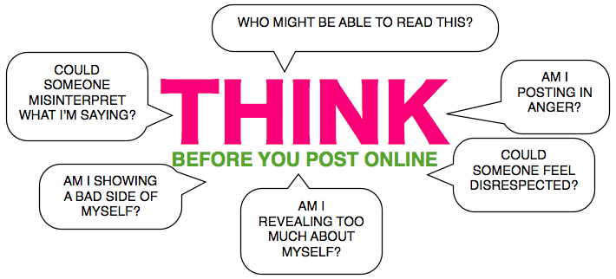
Think Before You Post
What you do in cyberworld does have consequences in the real world.
You are not anonymous online – this means you can’t hide!
Notes:
Many people believe that they are anonymous online. Even if someone create a false profile for themselves, there are ways to track cyberbullying back to its source.
More importantly, disagreements online can become a part of our daily lives when we are face-to-face with people, and there can be real consequences for cyberbullying.
So don’t post angry. You may have heard the phrase “Think before you speak.” It’s the same with posting online. Take a few minutes or a few hours to think through some of these questions, because in many kinds of social media it’s not just the person you are writing to who may see it. Their friends and family may also see it and it’s important to be sure you are comfortable with anyone and everyone reading anything you post.
Think about who else may have access to reading your message after you post it. Would you want your friends to see you like this? Would you want your parents to see it? Would you want your friends’ parents to see it? If you can answer “No” to any of these questions, don’t post it.
Do you know what sarcasm is? Sarcasm is when you say one thing and mean another. An example might be if someone trips and you say, “Smooth move.” It’s not smooth when you trip, is it? Sarcasm is hard to understand in text, so think about how someone who doesn’t know you well might read it or misinterpret it.
Believing they are anonymous can give cyberbullies false courage and think they won’t get caught. So remember… if you wouldn’t say it to a person’s face, don’t say it online.
Before we go on to the next slide, why do you think kids cyberbully?

Slide 15
Why do kids cyberbully?
Angry at someone
Want revenge
Bored
Get Attention
Do it by accident
Be more popular
Defend self or friends
No matter the reason it can get you in trouble at school or with the police!
Notes:
You mentioned quite a few of these.
Read through any the students didn’t mention.
No matter why they do it, cyberbullies can still get in trouble for doing it.

Slide 16
Meanness Multiplies
1 in 2 cyberbullying messages is forwarded to more people
It’s hard to stop rumors from spreading online and their effects can be permanent.
Water = Rumor
Powder = Truth
Notes:
We talked a little about how many people can automatically see what you post. Now we’re going to talk about how messages can spread.
We’re going to a quick little demonstration about how rumors can spread on the Internet. Hold up the pitcher of Kool-Aid powder. Does anyone know what this is? Wait for responses. No, this is the truth, and the truth is that Reginald and I had pizza last night. It was because we had just come back from seeing a game at the school. While we were out having pizza, Susie saw us eating and sitting at the same table. And that’s the truth!
Show students the clear water. Does anyone know what this is? Wait for responses. No, this is rumor. A couple days later, Susie asked Reginald out to the spring dance. He said “Thank you, but no. I already have a date.” She felt hurt and jealous. Then she remembered she saw Reginald and I out at the restaurant the other night, so she goes on Facebook and posts, “Wanted to go to the dance with Reginald. Too bad he has all the time in the world for [Speaker] and none for me.”
Slowly and at an angle, pour water over powder, so it doesn’t mix together yet. Show it around the room. This is now Susie’s rumor on the Internet. Can you still see the separation between the truth and the rumor? Listen for responses. Can you separate the truth from the rumor at this point? Listen for responses. The truth would be hard to separate from the rumor, but it would be hard.
Now the rumor is on Facebook, and people are starting to read the comments. They start adding to the rumor. The rumor starts growing and spreading. It gets harder and harder to separate the truth from the rumor. Start stirring the contents of the pitcher together.
Can you see anymore where the truth ends and the rumor starts? Listen for responses. Do you think you could separate the truth from the lie anymore? Listen for responses. If a student says “Yes if you waited a really long time, it would dry out and leave just the rumor,” say, Yes, you could, but it would take a really long time and the truth would still never look the same.
From our one small truth (the powder) we’ve created this big pitcher of rumor. Start pouring Kool-Aid into dixie cups and have the other teen leaders hand them out to the class. So these friends shared the rumor both online and offline, and now all of you also have a little piece of the rumor, not the whole story. Now that it’s been passed around, we can never get it back under control.

Slide 17
What would you do?
Chris takes a picture of Sam in the locker room and posts in on Facebook. You’re friends with both of them on Facebook and see the picture. There are a lot of mean comments about it and several people have shared it.
Notes:
Go through the four R’s with the students:
Recognize
Refuse
Record
Report

Slide 18
What would you do?
David and Maria rush home after school many days to text their friends on their cell phones. Their parents let them text their friends, but they haven’t told their parents that every day for a week they received messages from someone they don’t know that are mean. “I hate you!” “You are so stupid.” “I’m going to beat you up!”
Notes:
Go through the four R’s with the students:
Recognize
Refuse
Record
Report

Slide 19
Questions?

